Slide 1




Knowledge
Quest
KnowledgeQuest is an interactive, command-line based quiz application designed to test and enhance users' knowledge across a variety of topics. By combining entertainment with learning, the app provides an engaging and educational user experience.
Ka
by Karthick A

Slide 2

Introduction
1
Interactive Quiz Format
2
Diverse Topic Coverage
3
Robust Error Handling
The quiz consists of multiple-choice questions with four answer options. Users select their answers and receive real-time feedback on their performance.
The application covers a wide range of topics to broaden and reinforce users' knowledge.
Comprehensive error management ensures a smooth user experience, even with unexpected inputs.

Slide 3
Aim of the Project
Develop Interactive Quiz Platform
Test and Enhance User Knowledge
Ensure Smooth User Experience
Create a dynamic and engaging tool for users to interact with and enjoy.
Provide a diverse range of questions to broaden and reinforce users' knowledge.
Implement comprehensive error handling to manage invalid inputs and maintain application stability.

Slide 4
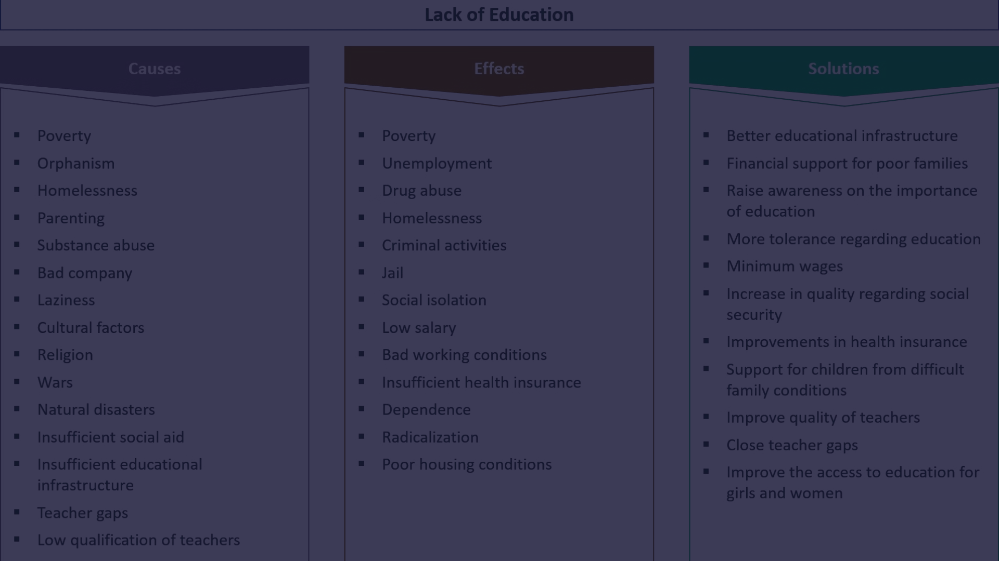
Business Problem
1
Lack of Engaging Educational Tools
2
Demand for Interactive Learning
There is a need for interactive and user-friendly applications to reinforce learning.
Users seek engaging platforms that combine entertainment with education.

Slide 5
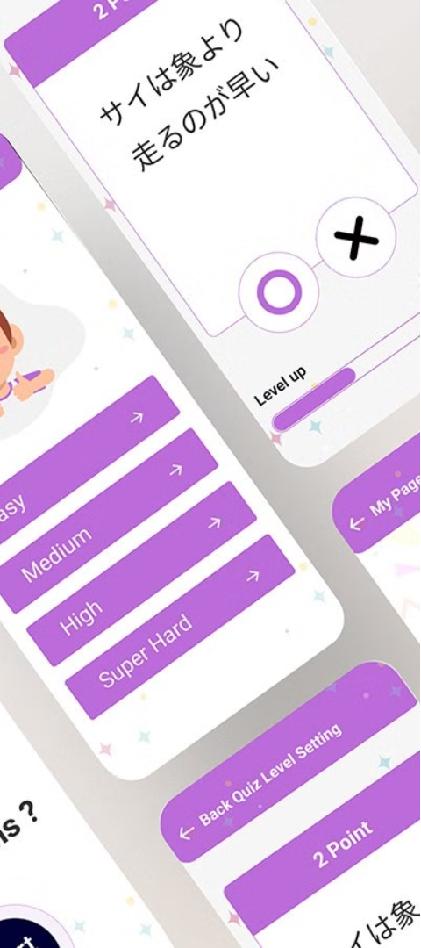
Project Description
1
Quiz Structure
The quiz consists of multiple-choice questions with four answer options. Users select their answers by entering the corresponding number.
2
Real-Time Feedback
Users receive immediate feedback on their answers, with the application indicating whether the response is correct or incorrect and updating the score in real-time.
3
Versatile Input Handling
The application gracefully handles different user inputs, including invalid responses and skipped questions, ensuring a smooth and robust user experience.

Slide 6
Input Versatility and Error Handling
Accepts Various Inputs
Skips Questions on Request
The application accepts a range of user inputs, including answers to questions and commands for skipping questions.
Users have the option to skip questions they do not wish to answer, enhancing user flexibility.
Graceful Error Handling
Robust Exception Handling
The application manages invalid inputs, providing appropriate feedback to the user without crashing.
Comprehensive exception handling mechanisms maintain application stability and reliability, even in the face of unexpected errors.

Slide 7




Results and Outcomes
High User Engagement
Effective Score Tracking
Smooth User Experience
Educational Value
Users are actively involved and interested in the quiz, leading to increased participation.
The application provides immediate feedback on users' performance, enhancing their sense of accomplishment.
Robust error handling ensures a seamless experience, preventing disruptions caused by invalid inputs.
Users benefit from a wide range of questions covering diverse topics, enhancing their knowledge base.

Slide 8



Conclusion
Achieved Objectives
Engaging and Educational
Effective Design and Implementation
The quiz application successfully met its goals of providing an engaging and educational user experience.
Users benefited from an interactive platform that facilitated learning through quizzes.
The project showcased effective design principles and robust implementation techniques.

Slide 9

Thank You
Your support and guidance have been instrumental in this journey. Thank you!

